Slide 1
Reduce Emissions! Perspectives on Expanding and Improving Public Transport COP21 – Paris, 3.12.2015 Asbjørn Wahl Chair of the ITF Urban Transport Committee Chair of the ITF Working Group on Climate Change

Slide 2
Climate change and transport
The transport sector is responsible for about 13% of total GHG emissions at the global level (UNIPCC)
Much higher in rich countries (US – 26%, EU – 19%)
23% of CO2 from fossil fuel from transport (OECD 30%)
The OECD countries represent only 20% of world population, but stand for 2/3 of total emissions
Transport emissions have increased 120% during the last 30 years, and are still increasing all over the world

Slide 3
“Emissions from transport are expected to rise 30 percent by the year 2030 and 75 percent by year 2050, with most growth coming from private vehicles.” (ITF/UITP)
Increase – not decrease!

Slide 4
Private cars the biggest problem
Increased transport emissions often more than outweigh reductions achieved in other parts of the economy
Road transport is responsible for 3/4 of transport emissions, and private cars are the biggest contributor
The number of private cars is growing rapidly – expected from 700 million in 2005 to 2 billion in 2050
Thus, the positive effects of more energy-effective cars are also outweighed by the enormous increase of cars

Slide 5
How to cut transport emissions
There are three ways to cut emissions from transport – the so-called “Reduce – Shift – Improve” strategy:
1. Better technology (“the technological fix”)
2. To shift from transport modes with high emissions to modes with lower emissions (“the modal shift”)
3. To reduce the need for transport
In cities, a massive modal shift from private cars to public transport will have to take place

Slide 6
“Public transport has a major role to play in controlling and reducing greenhouse gas emissions. If Public Transport was expanded to twice its current size, GHG emissions per capita would decrease by 60%.” (ITF/UITP)
PT has a huge potential

Slide 7
Acknowledge the failures
Climate change policies so far have failed to reduce the emissions of GHG – emissions have increased
Market forces have been given priority over politics
Deregulation, privatisation, market orientation, fossil fuel subsidies, externalisation of costs, lack of land and urban planning, etc., prevent necessary political action
We face a problem of deep systemic dimensions
A completely new political approach is needed

Slide 8
“Any global attempt at limiting global average temperature rise to less than 2ºC without including the transport sector will not be successful.” (ITF/UITP)
Transport is desisive

Slide 9
What has to be done?
PT has to be brought under public, democratic control
Investments in PT infrastructure and systems are to be expanded to allow for a doubling of PT in 10 years
External costs have to be internalised in all transport, and all fossil full subsidies have to be abolished
As PT is improved, private cars must be restricted
Long term, land use/urban planning are key to reduce transport needs and create an efficient PT system
Broad social alliances for PT have to be built

Slide 10
Land use / urban planning

Slide 11
Public transport and jobs
There are about 7 million public transport workers in the world today, and it should be doubled by 2030
About 30 jobs are created for every 1 million Euro invested in public transport infrastructure
About 57 jobs are created for every 1 million Euro used in the operation of public transport
Investments in public transport have a multiplier of 2 – 2,5 (some places up to 4,1)

Slide 12
Benefits of expanded PT
In addition to less GHG emissions, expanded and improved PT systems have many other benefits
Less congestion, which also means less travel time
Less pollution, which also leads to less health problems
Improved mobility gives increased individual freedom – easier to get to work, to school, to friends, to a doctor…
Improved economy (US): Every $1 invested in PT generates approximately $4 in economic returns

Slide 13
Joint ITF-UITP declaration
“Fossil fuel consumption and dependency in transport systems should be reduced and subsidies eventually eliminated”
Expanding public transport will enable us “to meet wider sustainable goals like the creation of millions of new, decent jobs, direct and indirect”
Agree to develop “high standards of initial and vocational training, high standards of staff security, and developing formal employment and reducing informal employment to enhance public transport”

Slide 14
“A rapid expansion of good public transport services worldwide coupled with major infrastructure investment is the best strategy to counter the unsustainable growth in private motor transport.” (ITF/UITP)
We need urgent action!

Slide 15
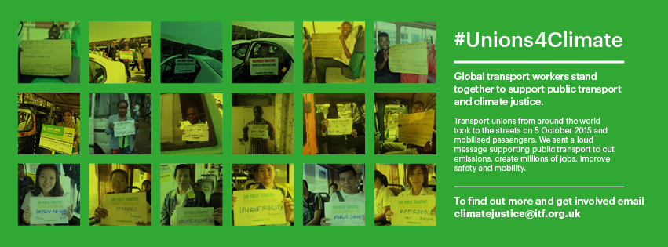
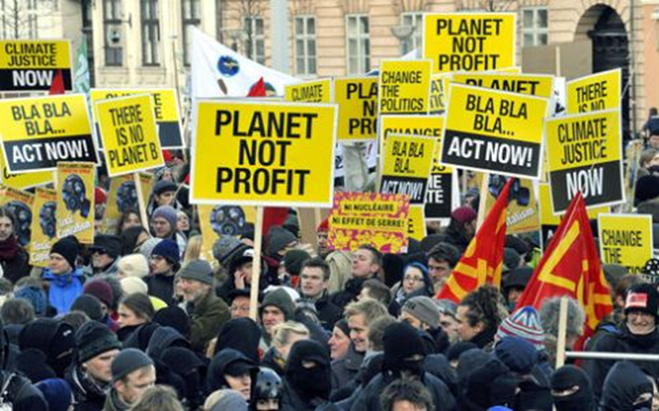
www.itfclimatejustice.org

